Slide 1
Construction of Geodatabase for New Braunfels Drainage and Right-of-Way Systems
FINAL PRESENTATION BY Genius, Inc.

Slide 2
Project Team Members
Scott Christensen
Project Manager
Brad Dillashaw
Assistant Project Manager
Sam Ortega
GIS Analyst
Kelly McGauhey
GIS Analyst
Jacqueline Carrillo
GIS Analyst, Web Developer

Slide 3
Why a Geodatabase?
To keep pace with growth
21,000 citizens and 15 mi²
Annexed areas
Annexed and historical files
Local Need:
Flood problems
Geodatabase could be preventative

Slide 4
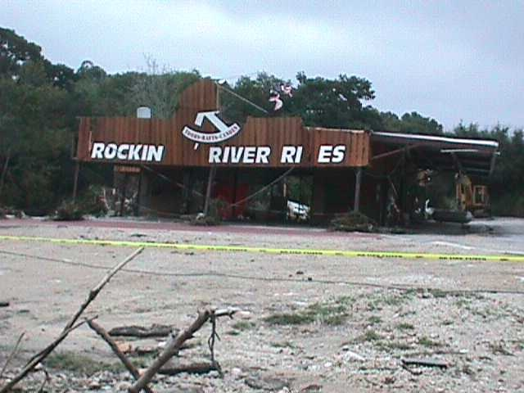
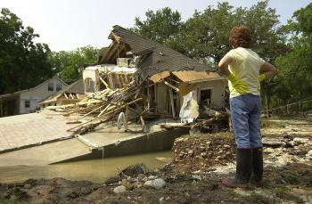
Broadway, 1998 & 2002
Broadway flood, 2002
Broadway flood, 1998

Slide 5
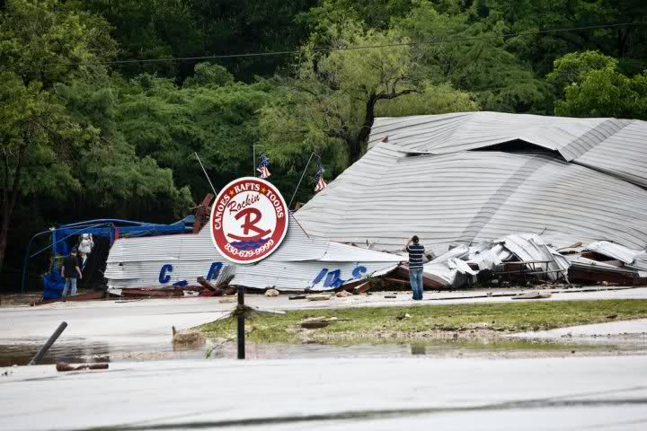
June 9, 2010

Slide 6
Introduction
Geodatabase use in Houston & other cities:
Infrastructure
Hazards
Financial decisions
Visual aids
In this presentation:
Describe geodatabase creation
Discuss software versions
Discuss GPS technology and interface
Make recommendations for the future

Slide 7
Scope Revisited
Original primary scope
Geodatabase functional with Garmin
5 block radius for data collection
Updated primary scope
Geodatabase compatible with ArcMap 9.3
Data collection compatible with ArcPad 7.1 on Trimble
Pilot data for functionality test

Slide 8
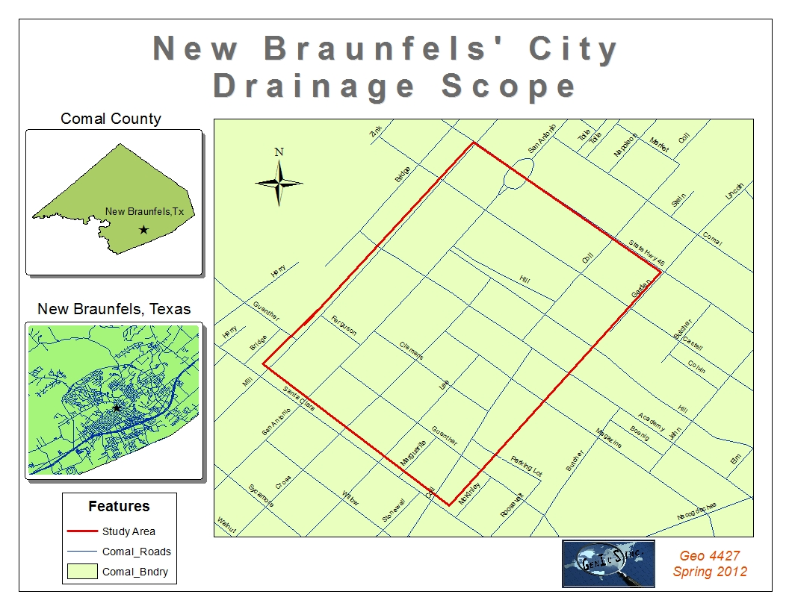

Slide 10
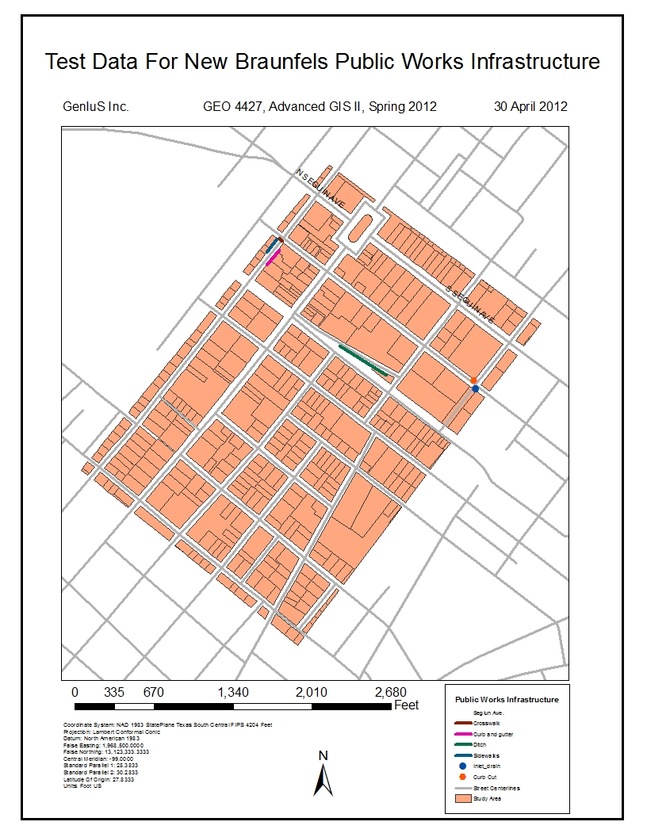
Final scope map with functionality test data.

Slide 11
Data
All data obtained from the City of New Braunfels
Focus on database design
Identifying various attribute fields from the data
Street centerline data
Other related fields depending on the feature class
Metadata
Created for geodatabase
Template for future metadata

Slide 12
Data (cont.)
Reference Shapefiles
City limits
Building parcels
Railroads
Address
School zone
Projected Coordinate System - NAD 1983 StatePlane Texas South Central

Slide 13
Methodology
ArcGIS Database Design
Feature classes:
Sidewalk
Crosswalk
Curb & Gutter
Ditches
Curb Cut
Inlet
Attributes:
Longitude & Latitude
Street Centerline
Street Side
Other attributes

Slide 14
Methodology (cont.)
Data Input
Subtype domains
Didactic fields
Relationship classes
Data Collection
Field data
ArcPad 7.1
Database Functionality Test

Slide 15
Sidewalk
Crosswalk
Notes
Longitude
Latitude
Street Segment
Street Side
Condition
Build Date
Ditch
GDB
Curb & Gutter
Maintenance Notes
Inlet
Curb Cut

Slide 16
Methodology (cont.)
Attritubute Name | Field Type | Description | Data Input
FEATURE | Text | Feature type | Drop-Down
ID | Long Integer | Feature ID | Input
LONG_1 | Double | Feature Longitude 1 | Input
LAT_1 | Double | Feature Latitude 1 | Input
LONG_2 | Double | Feature Longitude 2 | Input
LAT_2 | Double | Feature Latitude 2 | Input
ST_SEGMENT_ID | Long Integer | Street Segment Number (from Street Centerline data) | Input
ST_SIDE | Text | Odd/Even | Drop-Down
BUILD_DATE | Date | Date of Construction | Input
CONDITION | Text | Good/Fair/Poor | Drop-Down
WIDTH | Long Integer | Feet | Input
OFFSET | Long Integer | Feet | Input
TYPE | Text | Concrete/Asphault/Crushed Granite/Brick/Other | Drop-Down
 |  | *if other - specify in notes
Notes:
FEATURE | Text | Feature Type | Drop-Down
ID | Long Integer | Feature ID | Input
DATE | Date | Date | Input
NOTES | Text | Notes | Input
Maintenance Notes:
FEATURE | Text | Feature Type | Drop-Down
ID | Long Integer | Feature ID | Input
DATE | Date | Date | Input
MAINT_TYPE | Text | Maintenance/Repair | Drop-Down
MAINT_BY | Text | City of New Braunfuls/Other (if other - specify in notes) | Drop-Down
MAINT_NOTES | Text | Maintenance Notes | Input

Slide 17
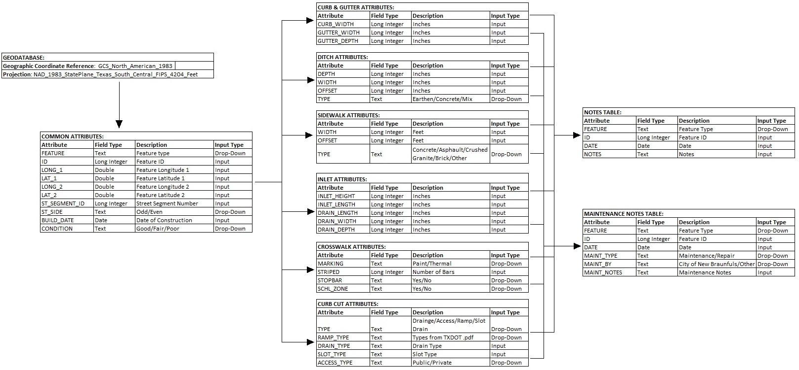
Methodology (cont.)
PHYSICAL DESIGN

Slide 18
Results
Geodatabase sent to New Braunfels Public Works
Functionality Test
Compatible to ArcMap 9.3
Compatible to ArcPad 7.1 on Trimble
Pilot data collection
Work flow

Slide 19
Results (cont.)
Curb Gutter
Cross Walk
Side Walk
Inlet Drain
Curb Cut
Maintenance Notes
Notes
GDB

Slide 20
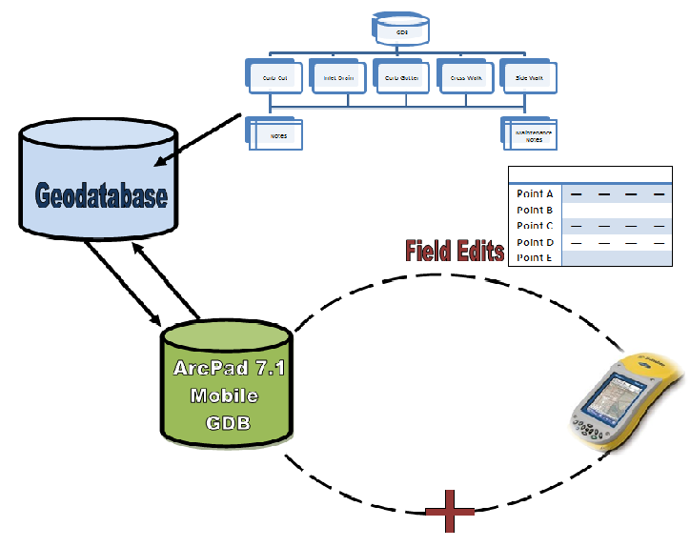

Slide 21
Discussion
Problems
Implications
Future for New Braunfels Public Works
Real world issues
Personal implications
Recommendations
Expand on data collection
Equipment upgrades
If We Were to Redo the Project

Slide 22
Summary
Geodatabase delivered on time
All deliverables accomplished on time
Our learning experience
Compatibility
Coupling programs
Reality check

Slide 23
Questions
Any Questions?
Genius Inc. Would like to thank the City of New Braunfels Public Works Department for their time and cooperation throughout the course of this project.

